Slide 1
Latches

Slide 2
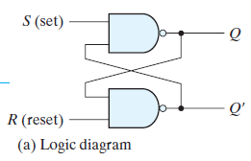
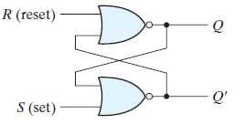
Latch
Latches and flip-flops are the building block of the sequential circuits.
The basic storage element is called Latch.
The output of the circuit will depends upon the present state(inputs) as well as on the sequence of the previous outputs of the circuits.
Eg: the cross-coupled inverters, shift registers, counters etc..
Notes:
The only difference b/w sequential and combinational is the memory block in sequential circuits we’ve memory element and it is sued to store the past output(single bit)which can be 0/1.

Slide 3
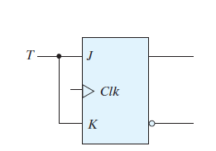
Latches and Flip-Flops
Latch
Flip-Flops
Does not have a clock signal(cycle).
It can be built from gates.
It always has a clock signal.
It can be built from latches.
Notes:
Uses:
Flip-flops can be used to store single bit, binary digits of data.
Store program information like RAM memory & Registers.
State of a latch/flip-flop is switched by a change in the control input.

Slide 4
SR Latch
Basic storage element.
2types:
NOR SR Latch
NANAD SR Latch
2 inputs S(set) & R(reset)
Outputs: Q, Q’
Q cannot be equal to Q’(both are complement of each other).
If Q=1(latch is set)
If Q=0(latch is reset)

Slide 5
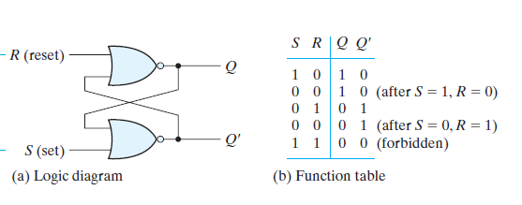
SR latch using NOR gate

Slide 6
Case i: S=0,R=1 ➔Q=0,Q’=1 (Latch is reset)
S=0,R=0 then Q=0, Q’=1 (memory condition)
(if data/input is removed, o/p of previous step is stored)
Case ii: S=1, R=0 then Q=1,Q’=0 (latch is set)
S=0, R=0 then Q=1, Q’=0 (memory condition)
Case iii: S=1,R=1 then Q=0, Q’=0 (not used, because Q and Q’ are complement of each other)
When S=0, R=0 ➔ Store data(input data is removed)
Notes:
If S=0, R=0 ➔ Q=0, Q’=1 if I start with Q.
If starts with Q’ then Q=1, Q=0
These conditions are not used.

Slide 7
S | R | Q | Q’
0 | 0 | Memory
0 | 1 | 0 | 1
1 | 0 | 1 | 0
1 | 1 | Not used

Slide 8
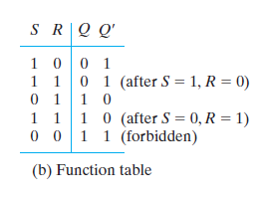
SR latch using NAND gate

Slide 9
Case i: S=0,R=1 ➔Q=1, Q’=0 (Latch is set)
S=1,R=1 then Q=1, Q’=0 (memory condition)
(if data/input is removed(S change its state and R maintain its state, o/p of previous step is stored)
Case ii: S=1, R=0 then Q=0,Q’=1 (latch is reset)
S=1, R=1 then Q=0, Q’=1 (memory condition)
Case iii: S=0,R=0 then Q=1, Q’=1 (not used, because Q and Q’ are complement of each other)
When S=1, R=1 ➔ Store data(input data is removed)

Slide 10
S | R | Q | Q’
0 | 0 | Not used
0 | 1 | 1 | 0
1 | 0 | 0 | 1
1 | 1 | memory

Slide 11
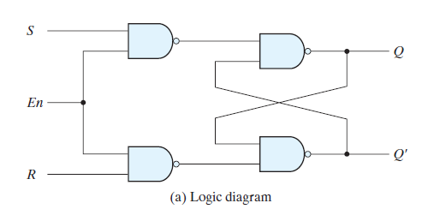
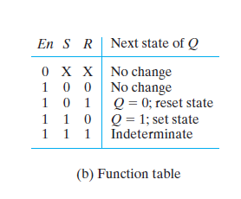
SR Latch using Enable

Slide 12
When E=1
Case i: S=1,R=O ➔Q=1,Q’=0 (Latch is set)
S=0,R=0 then Q=1, Q’=0 (memory condition)
Case ii: S=0, R=1 then Q=0,Q’=1 (latch is reset)
S=0, R=0 then Q=0, Q’=1 (memory condition)
Case iii: S=1,R=1 then Q=0/1, Q’=0/1 (not used, because Q and Q’ are complement of each other)
When E=0
then no change

Slide 13
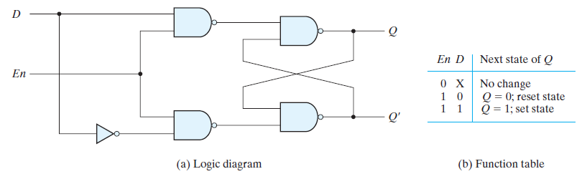
D Latch

Slide 14
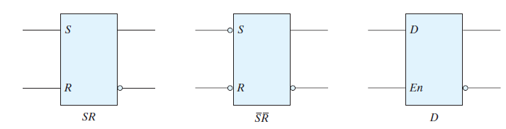
Graphic Symbols

